Slide 1
Predicting Book Ratings
The story of our project begins!

Slide 2
Presentation By:
Shmuel Maor
Simon Lukin

Slide 3
Our Research Question:
How accurately can we predict a book’s rating score by examining different aspects of it?
Genre
Author
Language
Publish Date
Number of Reviews
Number of Ratings

Slide 4
Our Process
Data Crawling
Data Cleansing
Machine Learning

Slide 5
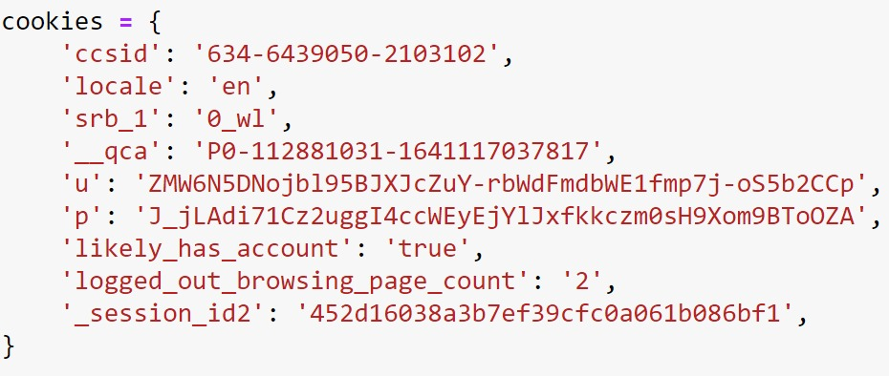

Slide 6
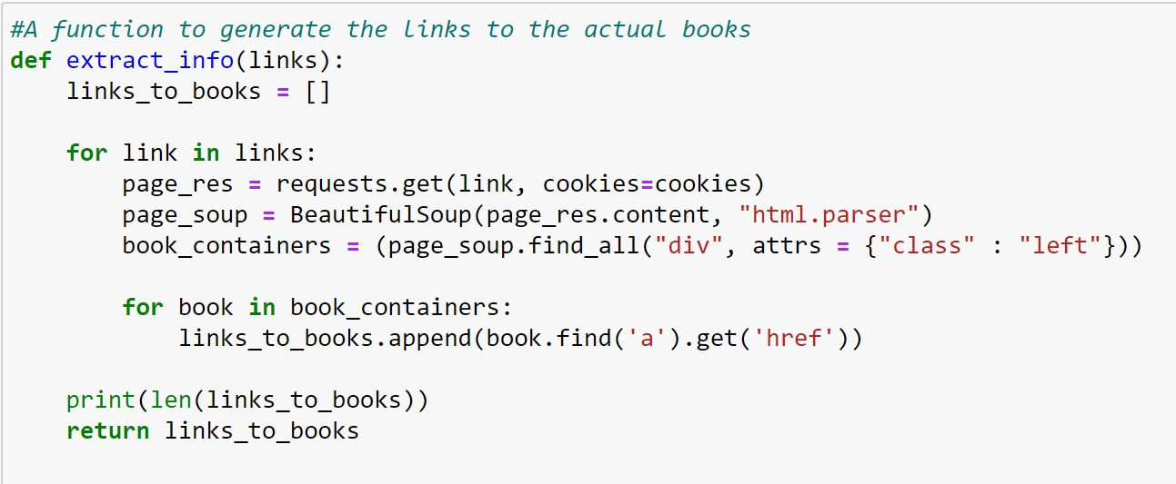

Slide 7
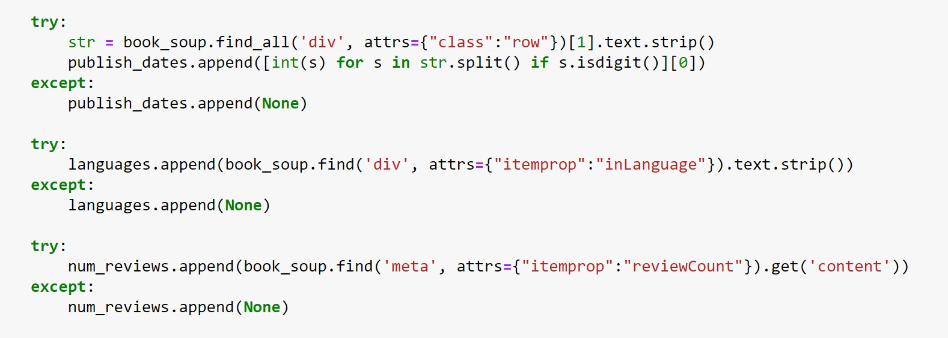

Slide 8
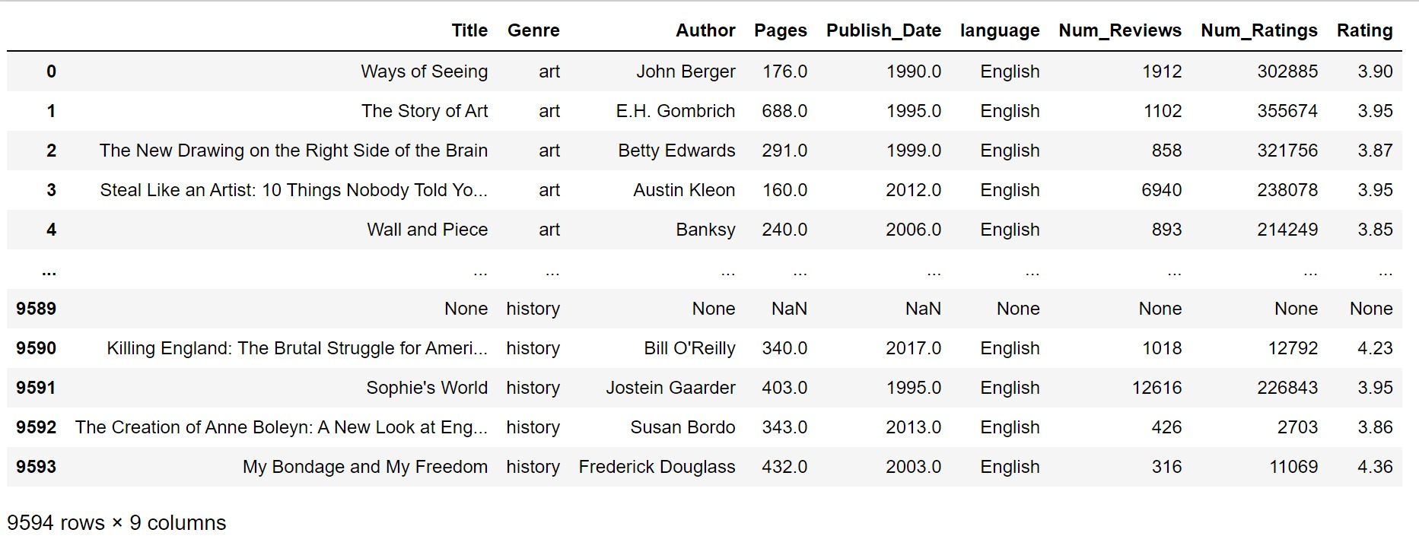

Slide 9
Our Process
Data Crawling
Data Cleansing
Machine Learning

Slide 10
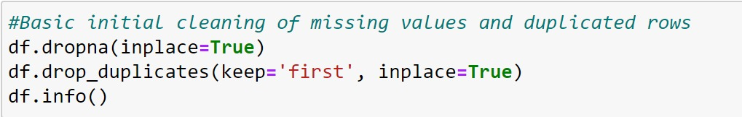
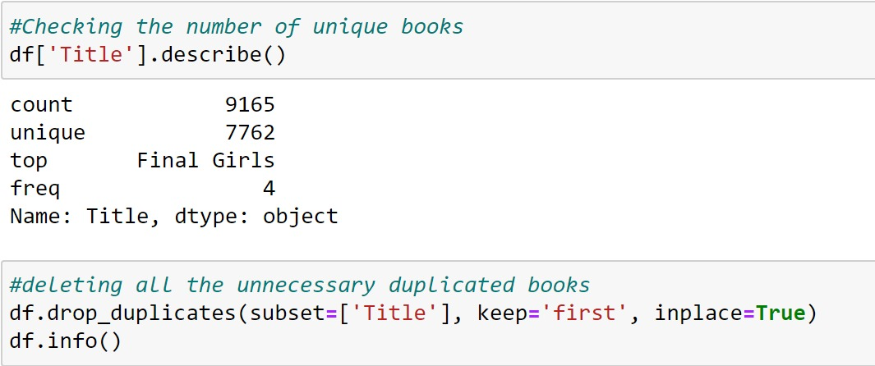

Slide 11
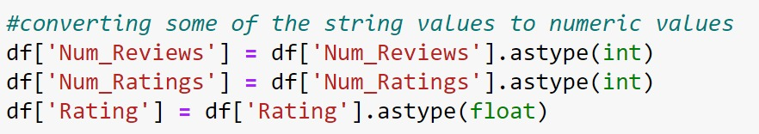
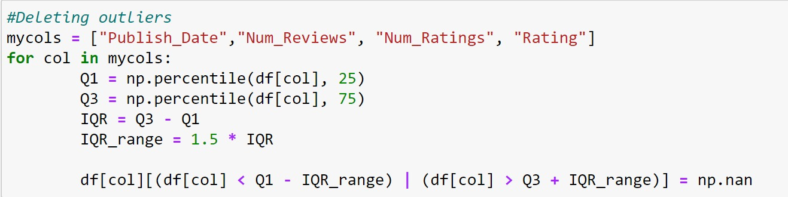

Slide 12
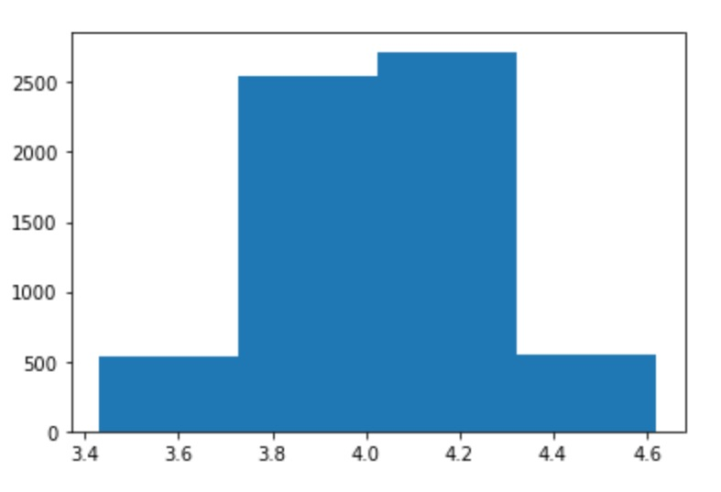
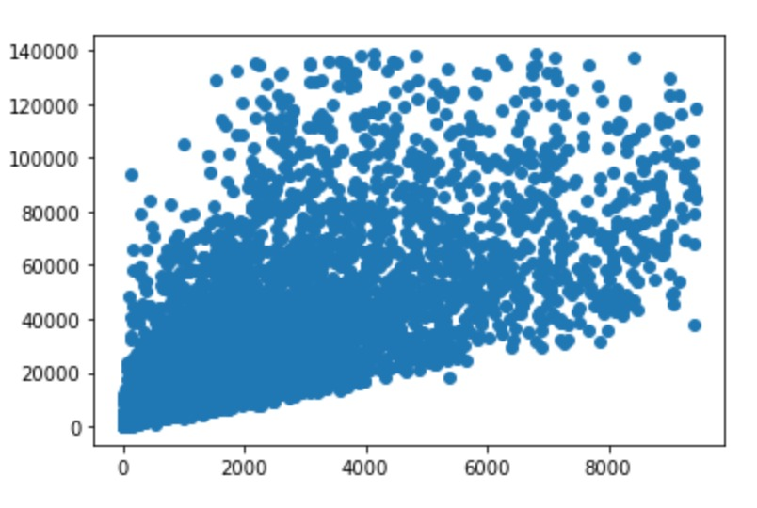
A scatterplot of the number of ratings X the number of reviews
A histogram of book rating

Slide 13
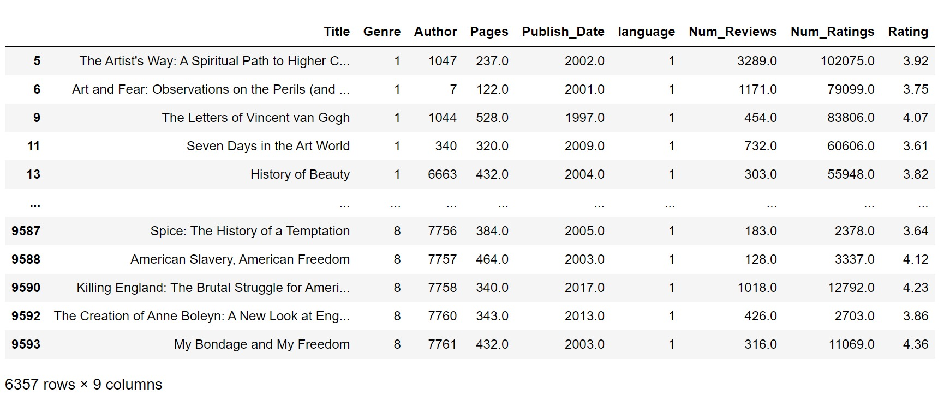

Slide 14
Our Process
Data Crawling
Data Cleansing
Machine Learning

Slide 15
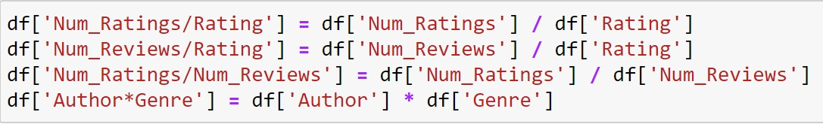
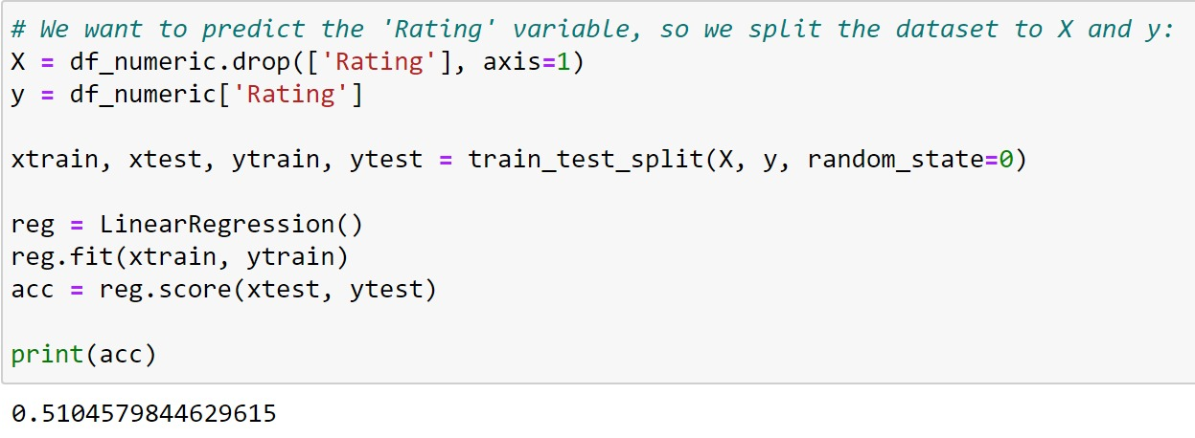
Feature engineering

Slide 16
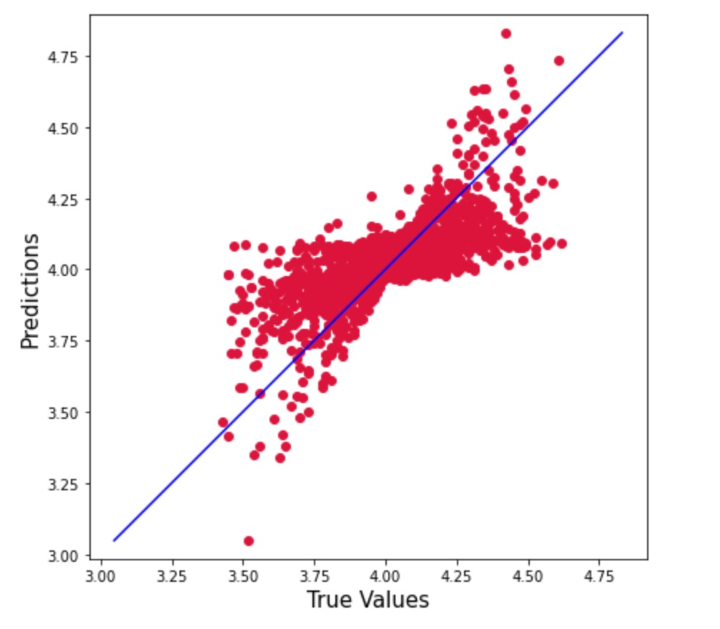

Slide 17
Conclusions
We found a lower correlation than expected between the different aspects of the book and its final rating;
Much feature engineering was needed to get even a passable score
Our final acc achieved was about 0.51

